Slide 1
Interfacing the Internet of a Trillion Things
Brad Campbell, Pat Pannuto, and Prabal Dutta
University of Michigan
SWEC’15 – April 13, 2015

Slide 2
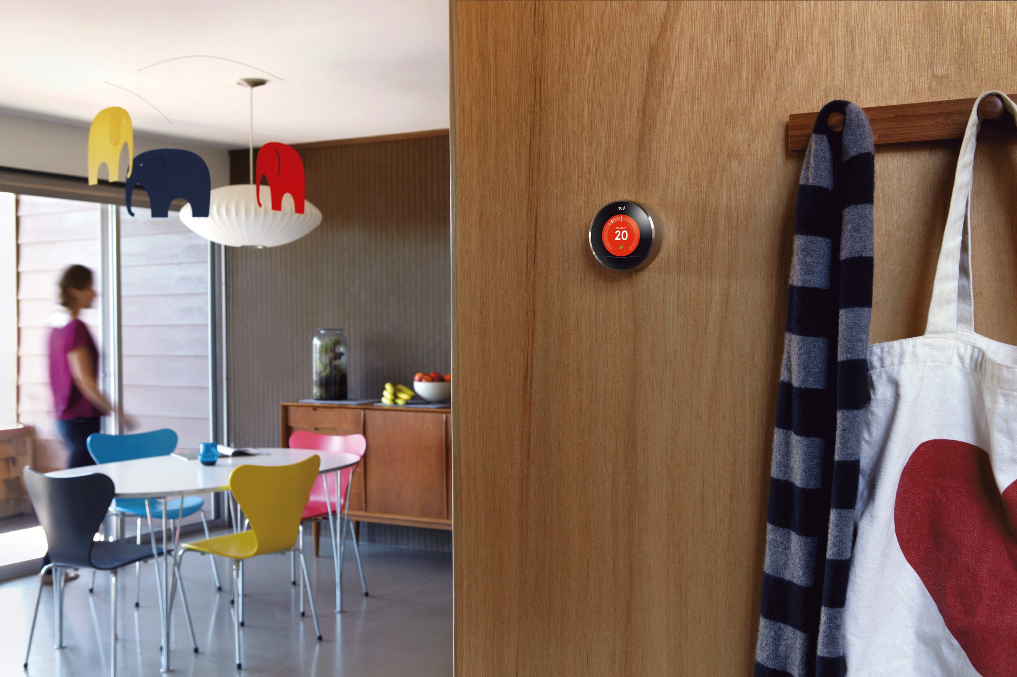
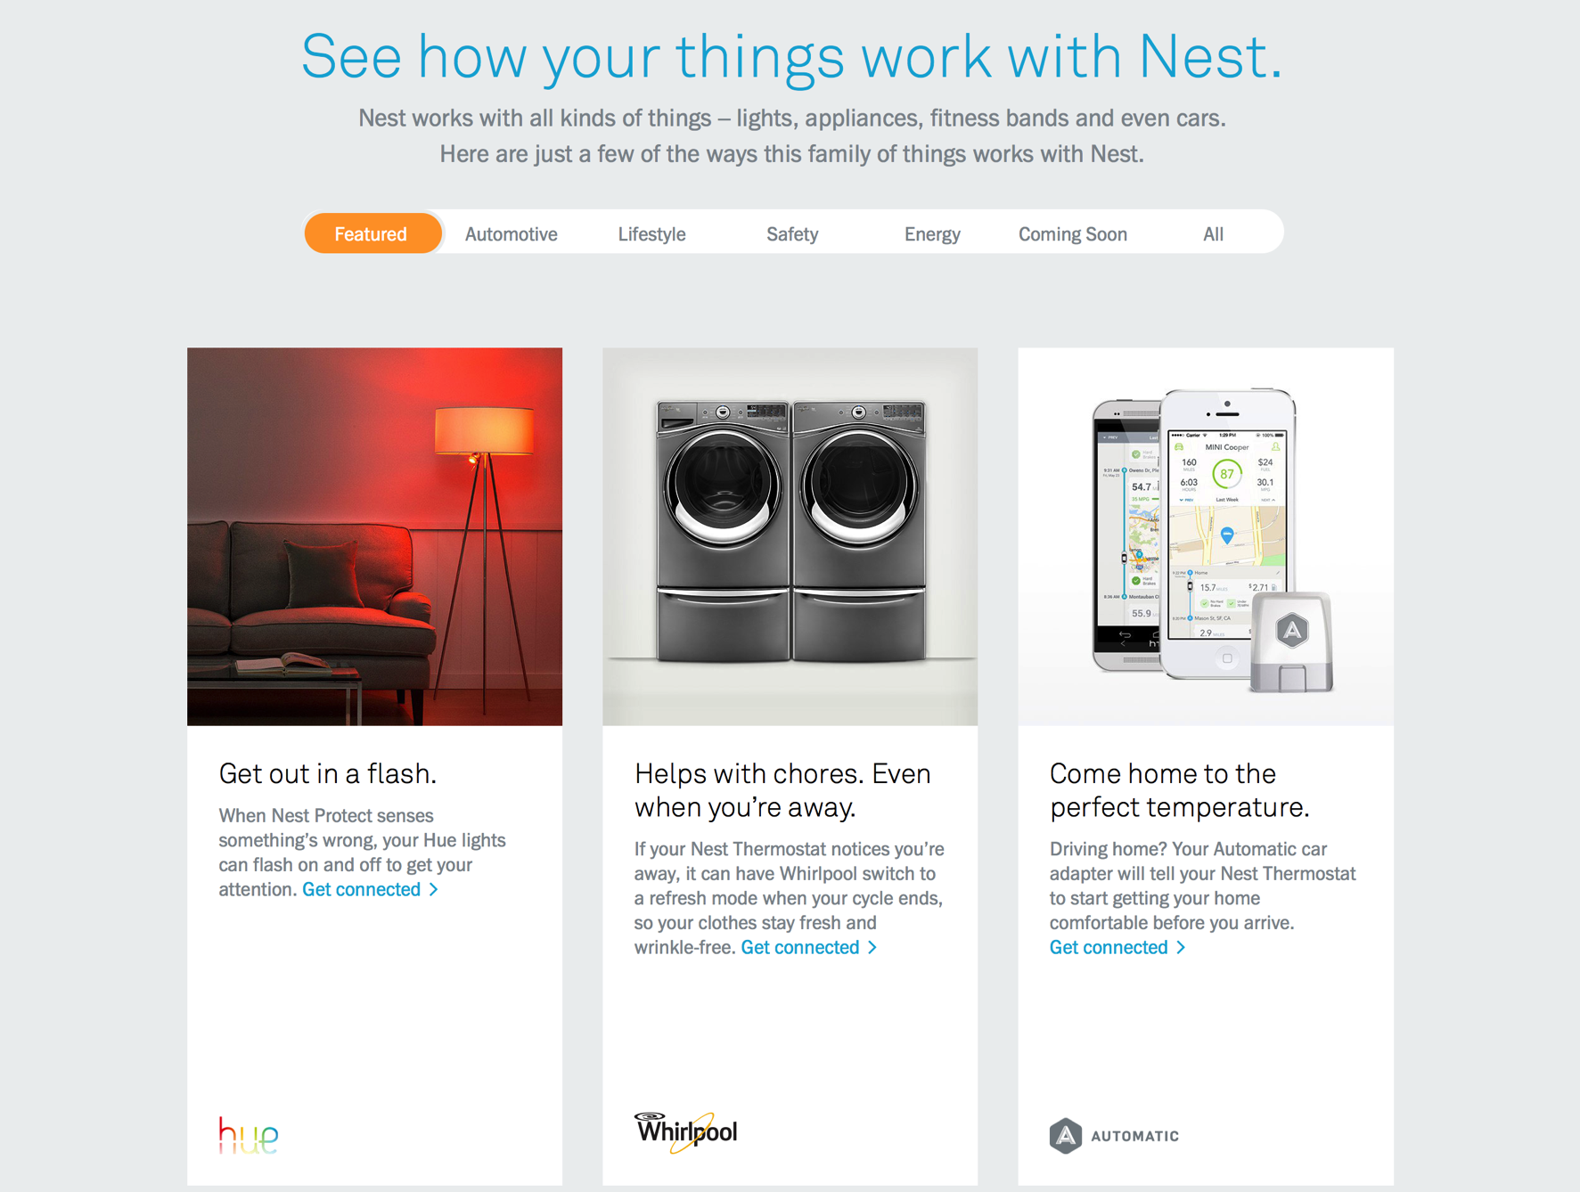
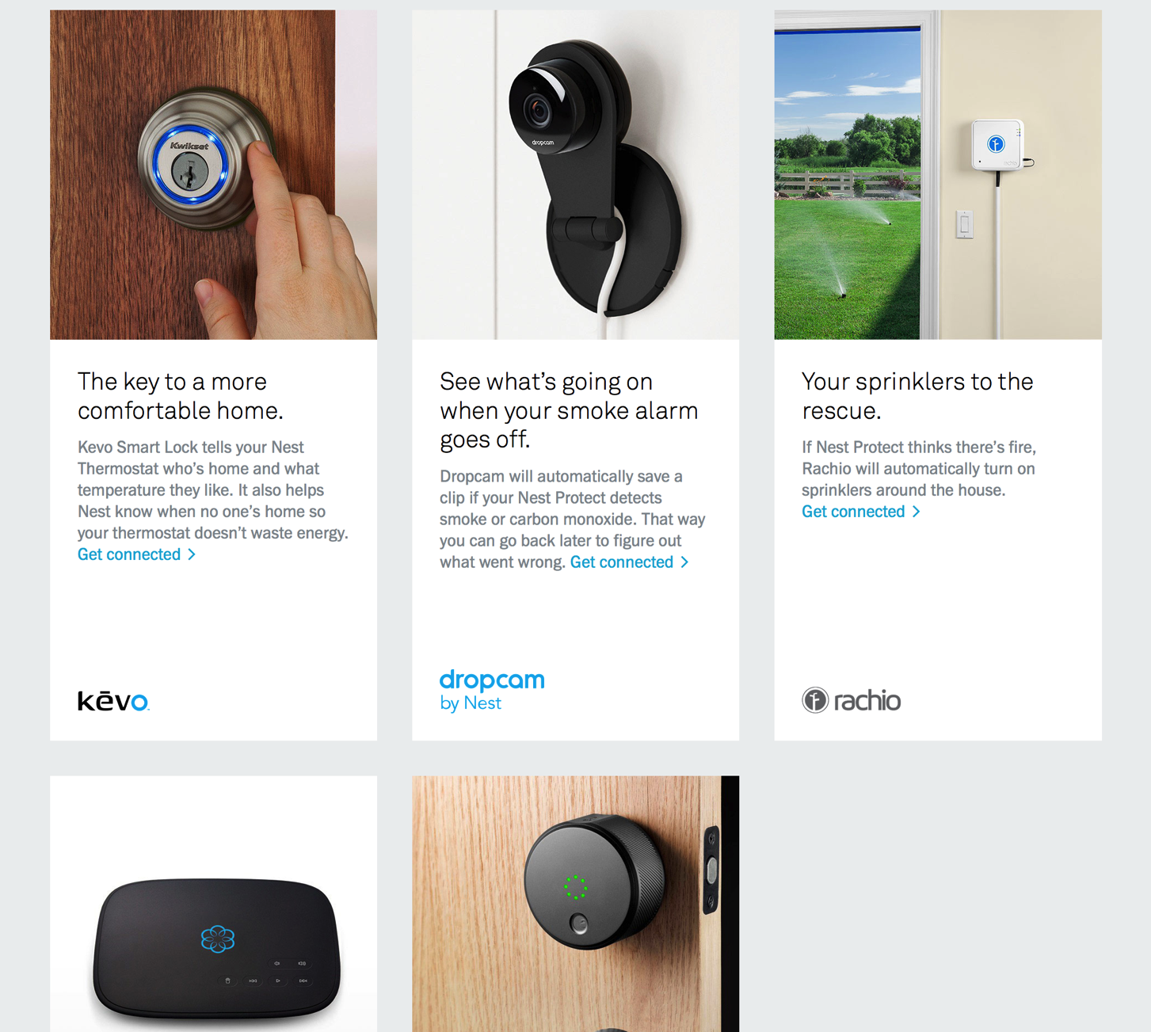
2

Slide 3
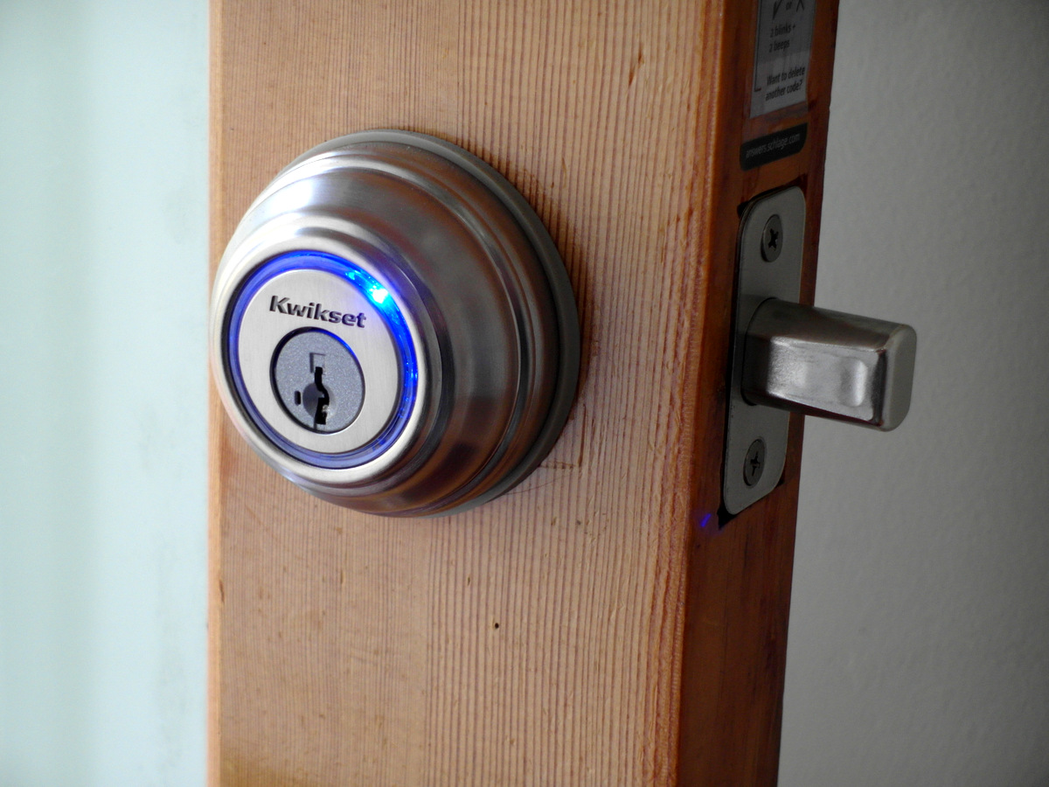
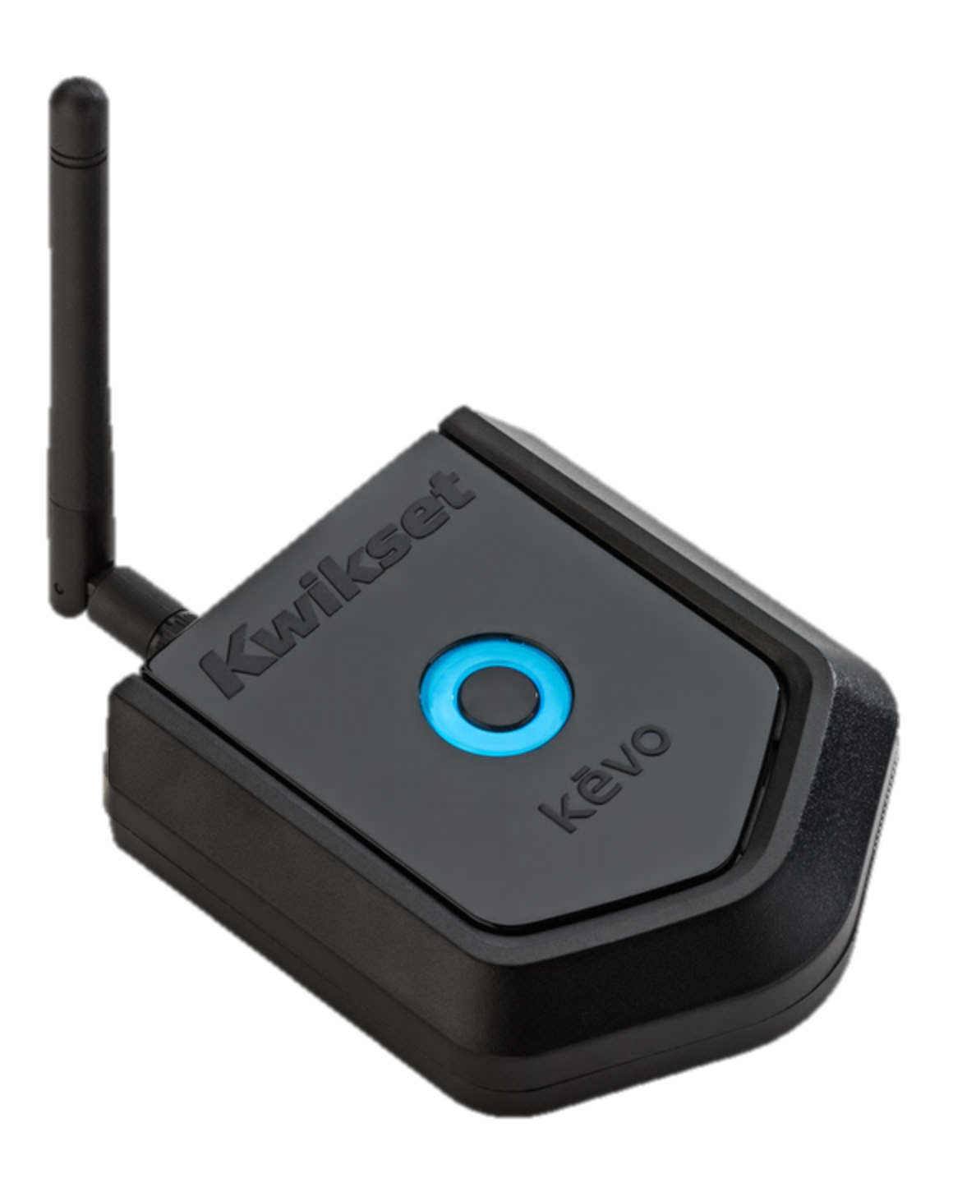
Kevo: BLE controlled deadbolt

Slide 4

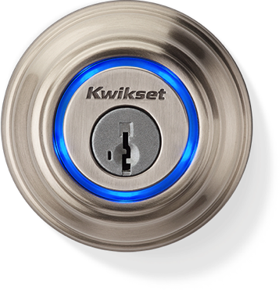
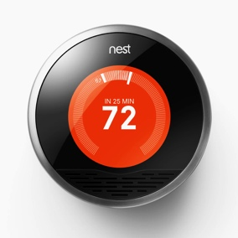
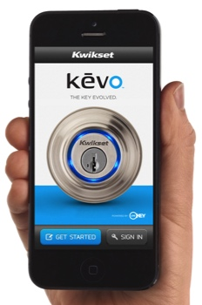
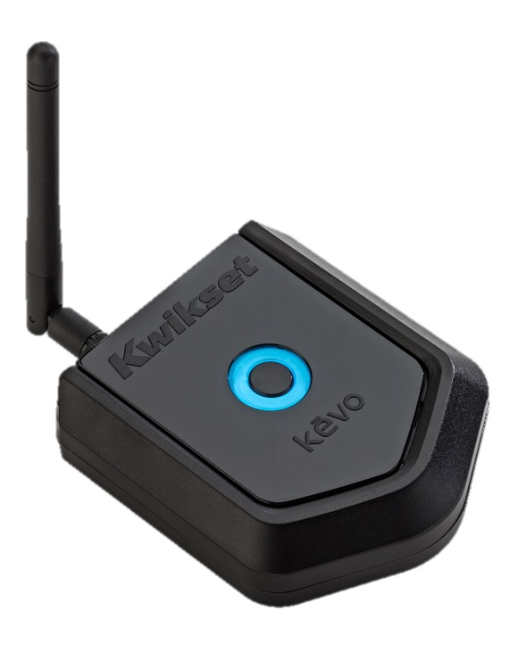
Implementing “When I enter my house, turn the AC on.”
Kevo
25 ft
Nest
Clumsy, and two companies now know that I unlocked my door.

Slide 5
Finding a better way to create applications
Peer-to-peer
Device to device
Local infrastructure-mediated
Devices in a room

Slide 6
The cloud is not essential for many applications
Direct device communication
Local applications
+

Slide 7
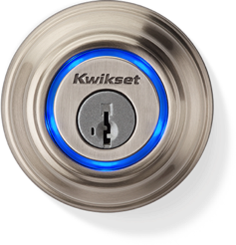
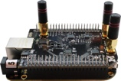
Initial setup, configuration, and authorization may require complex interactions and cloud interaction
Kevo
Nest
…but device interactions likely do not.

Slide 8
But, in practice, connecting devices is not as simple as drawing arrows
Devices use a wide range of protocols
Unclear if standardization will happen
https://entrepreneurshiptalk.wordpress.com/2014/01/29/the-internet-of-thing-protocol-stack-from-sensors-to-business-value/

Slide 9
But how can we get to a point where it is? (At least at the application level)
Example: control lighting based on occupancy
“Room occupied”
“Mark entered”
“Mark left”
“Room empty”
Overhead lights
Occupancy Event Service
Mark’s
Hue Bulb

Slide 10
One step further: allow many types of application creation tools
Pictorially
Voice commands
“Siri, make sure my garage door is closed when no one is home”
Automatic
Learn and copy behaviors
Based on logic expressions
( Person ∧ Nighttime ) ⇒ Lighting
In code
Write functions directly
Others

Slide 11
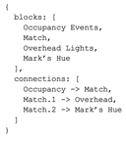

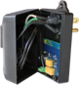
Breakdown the high level application creation problem to enable progress on many layers
NLP
Inference
Optimization
Application Description
Partitioning
Discovery
Devices

Slide 12
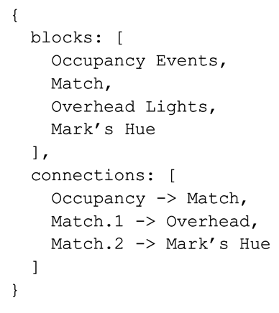
What layers have we been focusing on?
Device Wrappers
Application Specifications
Implementation Platforms
SB

Slide 13
Accessors (UofM Version)
Device APIs and protocols are not standardized
Goal: provide applications common device interfaces
input
output
Device
observe

Slide 14
Port Model for devices
input
output
Device
observe
Why ports?
URLs: http://swarmbox.local/device001/ports/Power
Pictorial representation
Multiple devices can each have the same port

Slide 15
Ports are grouped into interfaces
/onoff
{
ports: {
Power: {
direction: inout
}
}
}
/lighting/light
{
extends: [ /onoff ],
ports: {
Brightness: {
direction: inout
}
}
}
/lighting/light
Devices provide interfaces
Allows for fanout applications:
“Control all devices that implement /lighting/light”
“Turn off all devices that implement /onoff”
/onoff
B
P

Slide 16
Each device is described by a JavaScript file
GenericPowerMeter.js:
function init () {
provide_interface('/onoff');
provide_interface('/sensor/powermeter');
}
function Power (state) {
rt.http.post(get_parameter('URL') + '/Power', state);
}
function PowerMeter () {
return rt.coap.get(get_parameter('URL') + '/Meter');
}
Designed to be easily written when adding a new device

Slide 17
That JavaScript file is parsed to generate a full description of the device
{
name: Generic Meter,
ports: [
Power,
PowerMeter,
…
],
parameters: [
URL,
…
],
dependencies: {
accessors: …,
}
}
Accessor
JavaScript
Compiler
Designed to be easily parsed by any application that wants to use the accessor

Slide 18
Accessors operate inside of a runtime
Execute the JavaScript accessor
Provide the standard library for use inside of accessors
import accessors
meter = accessors.new(“GenericPowerMeter”)
Meter.Power(true)
p = Meter.PowerMeter()
Node.js, Java, Python, web browser via RPC

Slide 19
What does this get us?
Model for devices
Code for communicating with devices
The ability to embed control inside of applications
Much more goes into how this works
Accessor Host Server
Synchronous JavaScript
More details at the poster session

Slide 20
Using accessors to build an application that controls the lighting in a room
Occupancy Event Service
Match
“Room occupied”
“Mark entered”
“Mark left”
“Room empty”
Power
Overhead lights
Events
Power
Mark’s
Hue Bulb
Manual Override
Events

Slide 21
This application can be described in some common format
{
blocks: [
Occupancy Events,
Match,
Overhead Lights,
Mark’s Hue
],
connections: [
Occupancy -> Match,
Match.1 -> Overhead,
Match.2 -> Mark’s Hue
]
}
Accessors, logic blocks, etc.
How they connect

Slide 22
Decoupling application description from implementation
Pictorially, connecting blocks
Natural language processing
Automated, based on inferences
Describing
Applications
Application Description
SwarmBox
Distributed computation
Direct device-to-device
Implementing Applications

Slide 23
Implementation 1: Cloudlet processing
Occupancy Understanding
BLE Sniffing
SB
Run Application Logic
Control

Slide 24
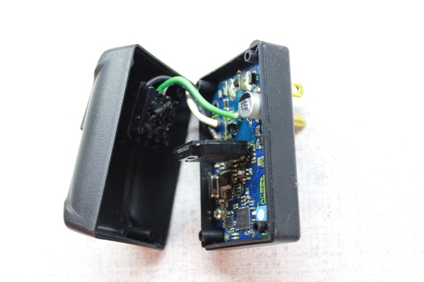
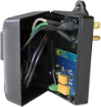
Implementation 2: Direct device-to-device
CoAP POST
AC Relay
Power Meter

Slide 25
There is much to be done
Currently a manual process to adapt implementations
Not sure what the application description should be
Partitioning, optimization, correctness

Slide 26
Accessors as a way to interface things and build applications
Port model for describing devices
JavaScript + runtime for interacting with devices
Ports help build an application description
Application can be executed in a variety of ways
Brad Campbell
University of Michigan
https://github.com/lab11/accessors

